Slide 1
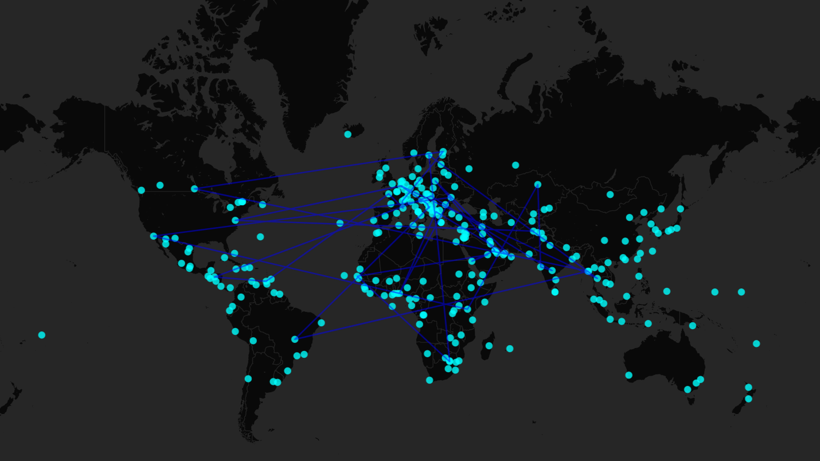
BUSINESS

Slide 2
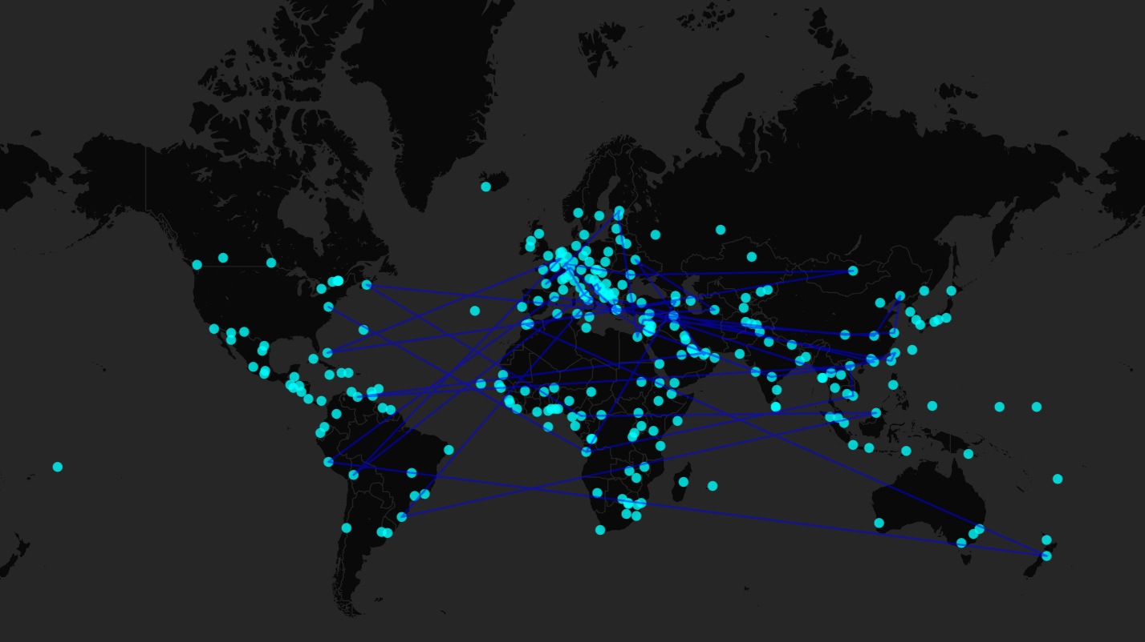
CULTURAL EXCHANGE

Slide 3
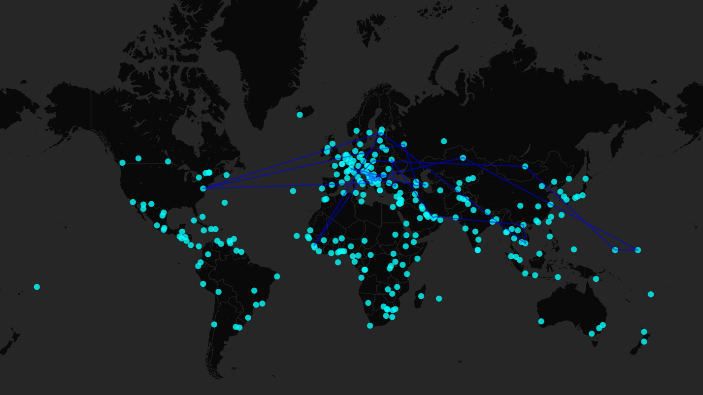
DEFENSE

Slide 4

EDUCATION

Slide 5
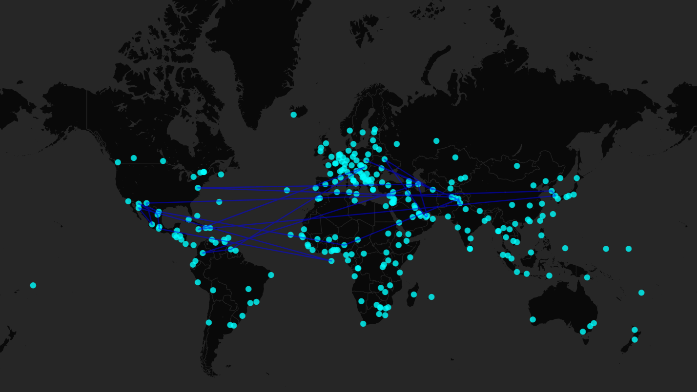
ENERGY

Slide 6
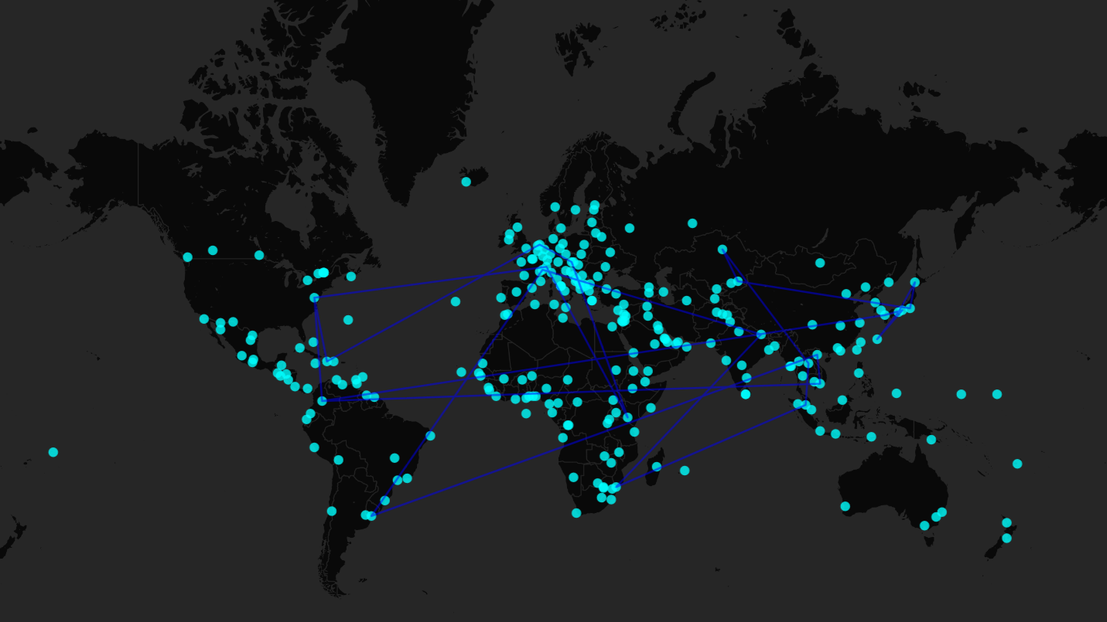
ENVIRONMENTAL PROTECTION

Slide 7
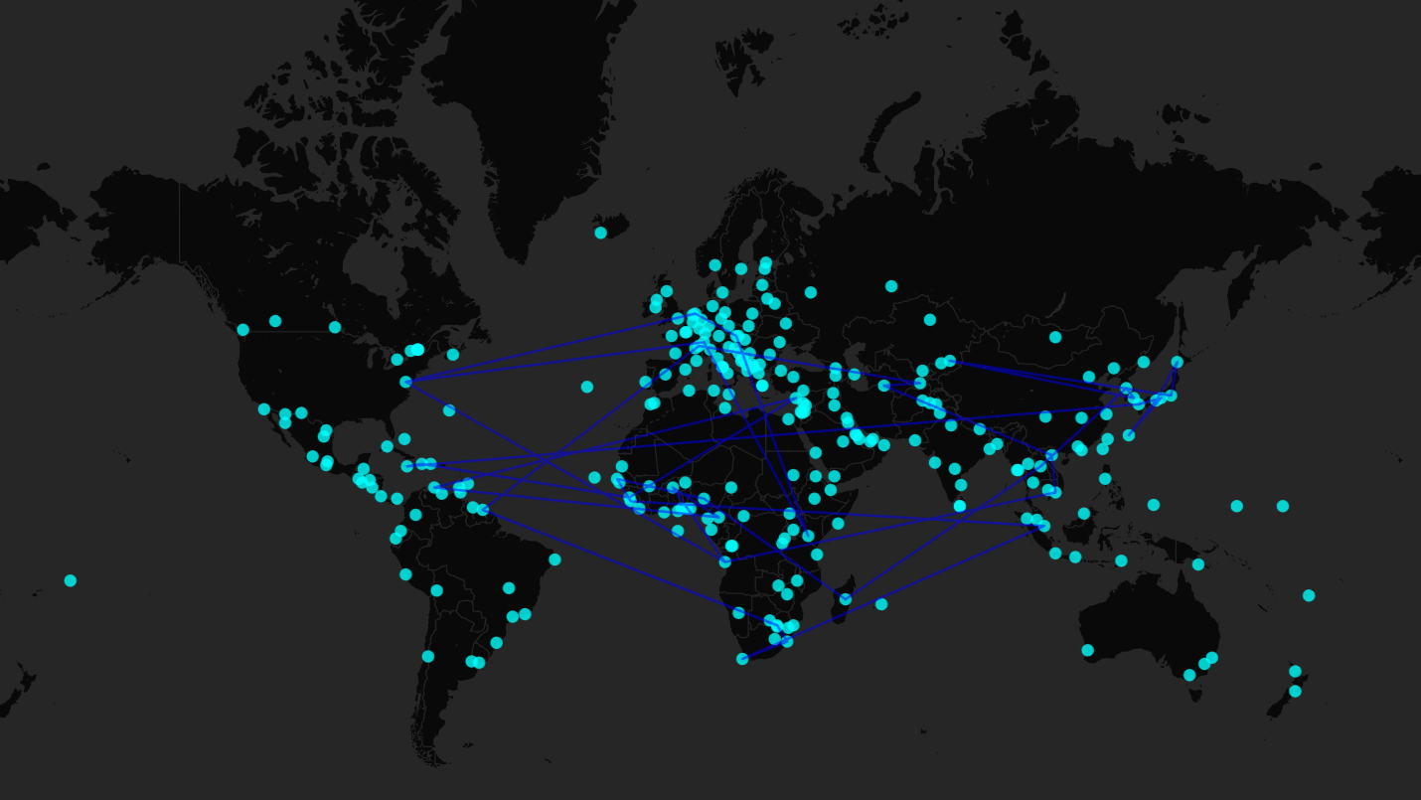
HEALTH

Slide 8
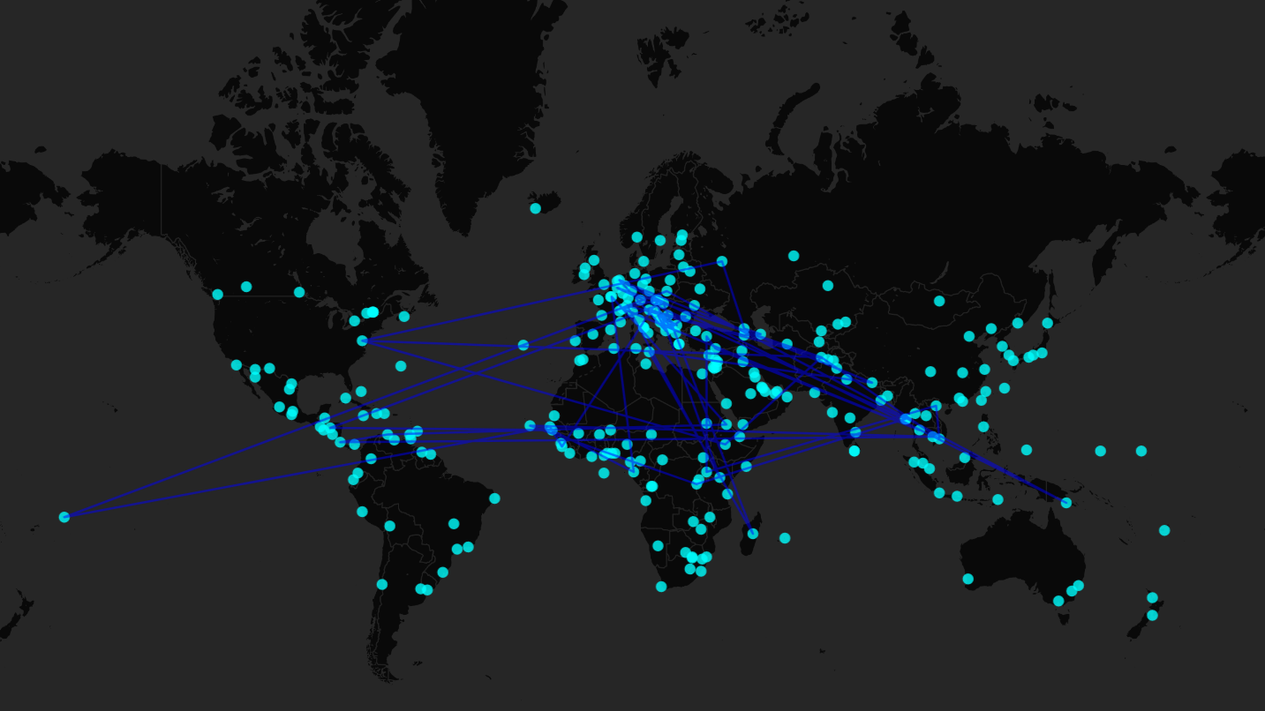
HUMAN RIGHTS

Slide 9
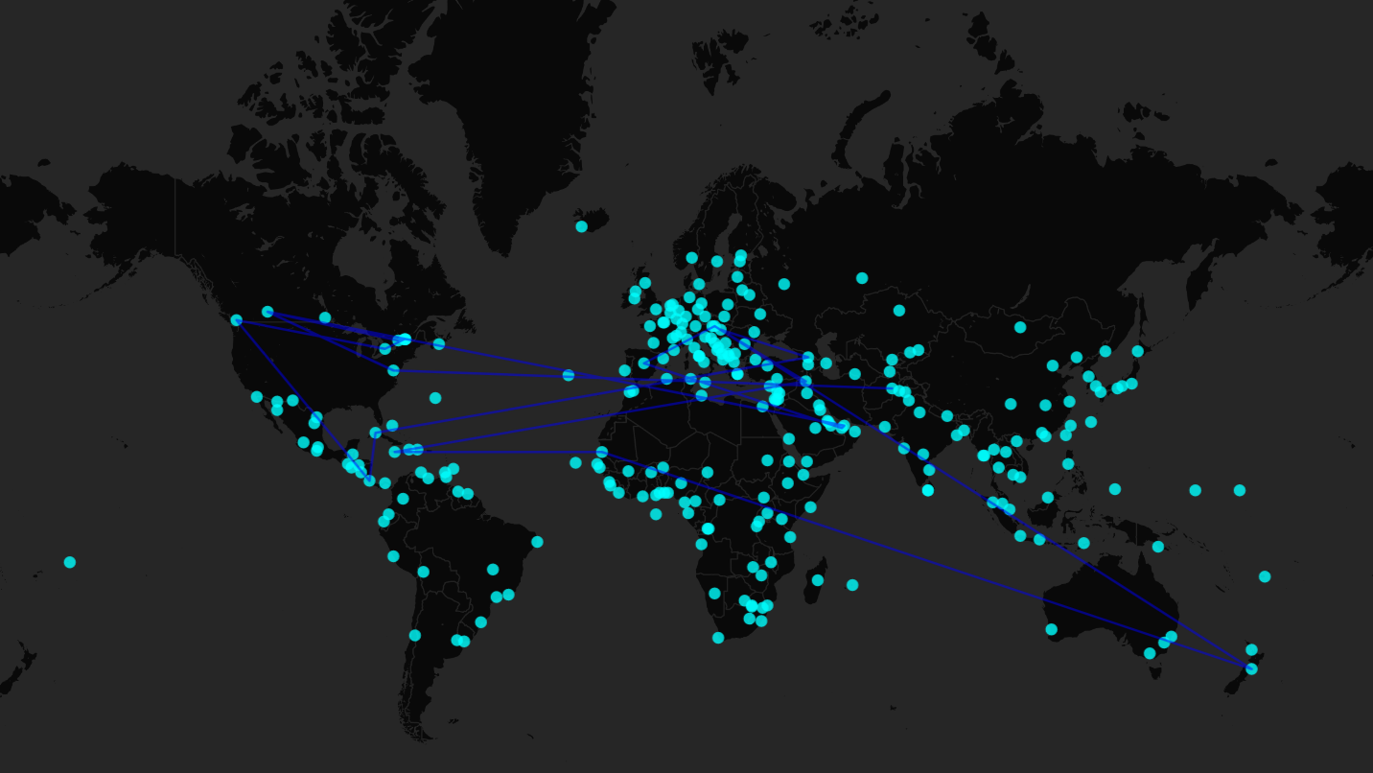
LAW ENFORCEMENT

Slide 10

NARCOTICS

Slide 11
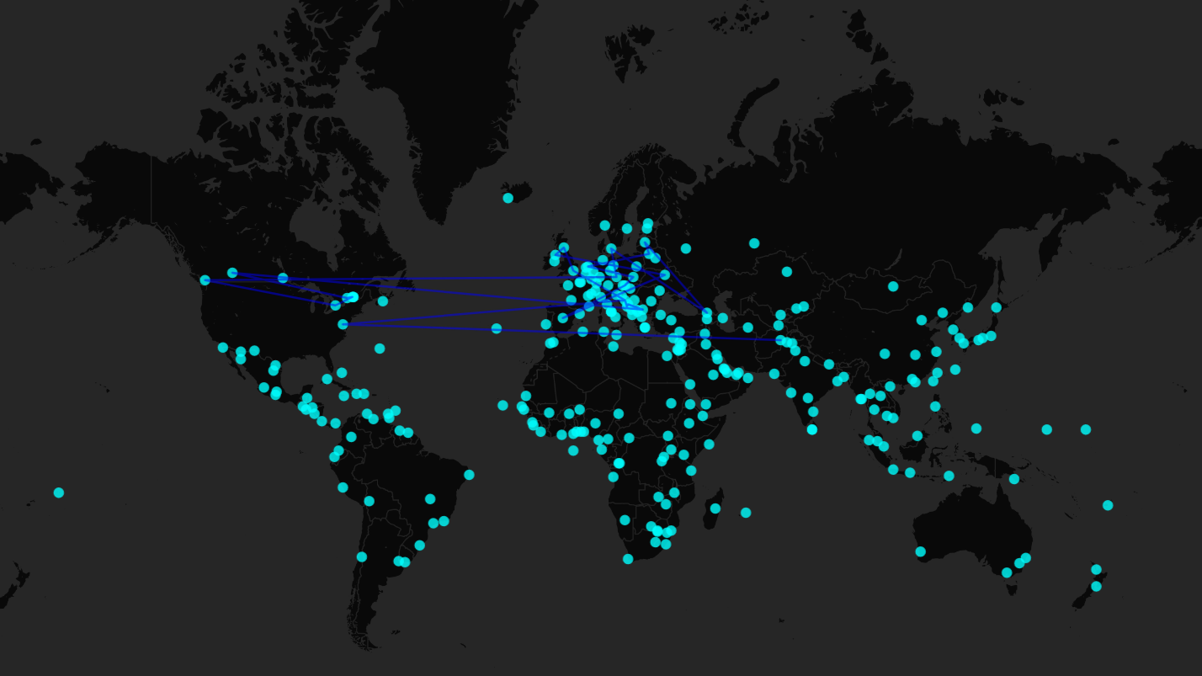
NATO

Slide 12
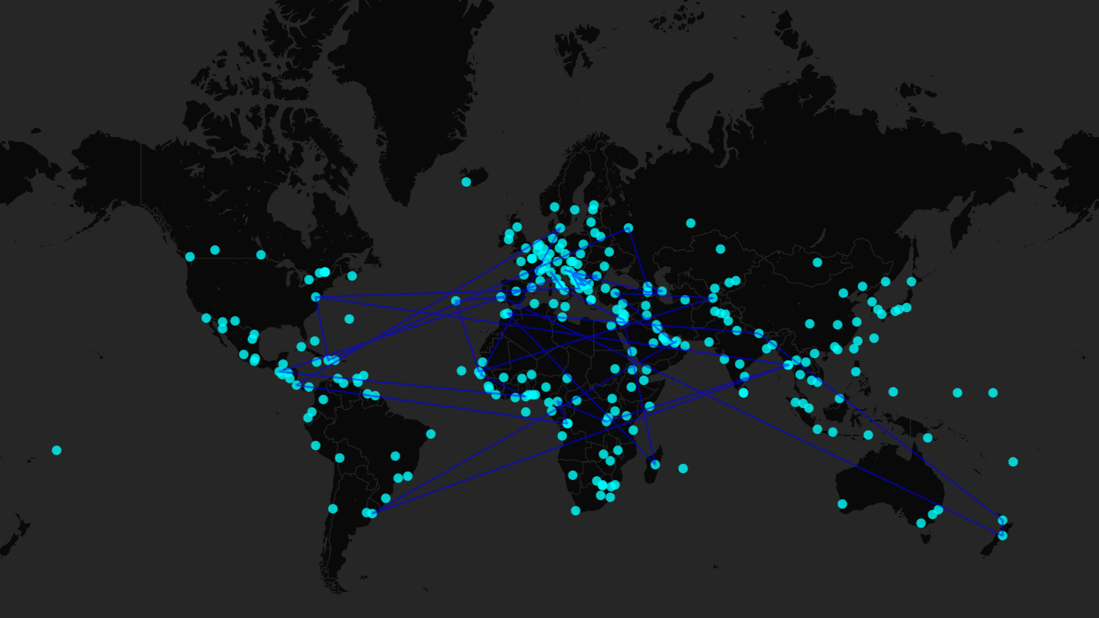
PEACE

Slide 13
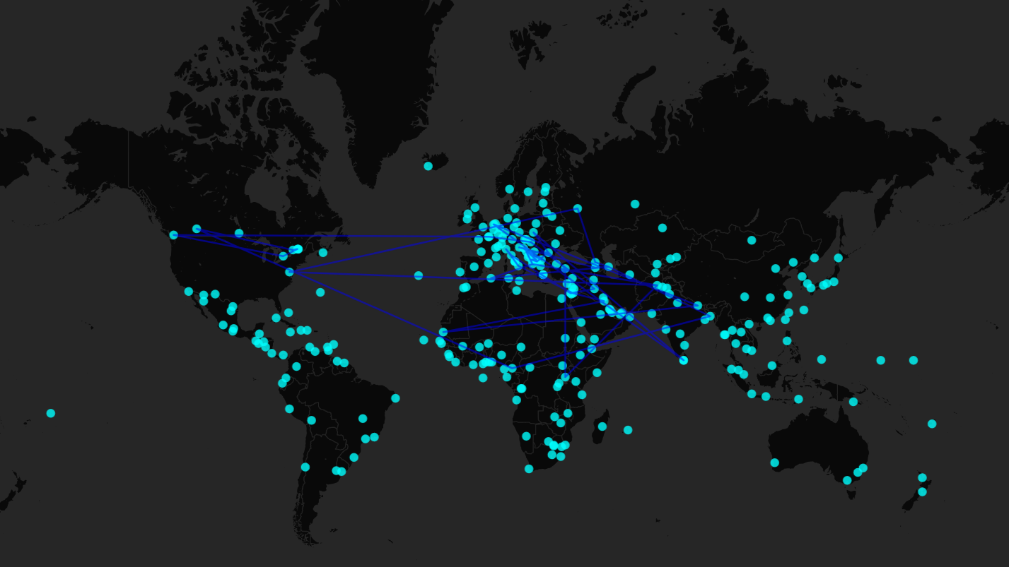
TERRORISM PREVENTION

Slide 14
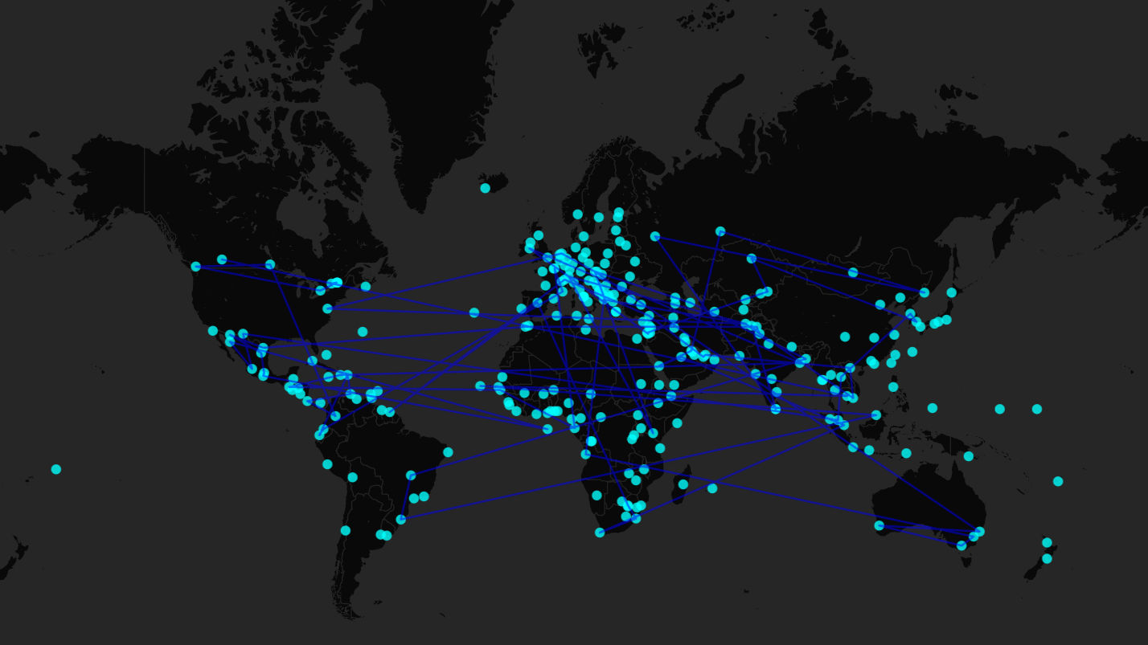
TRADE

Slide 15
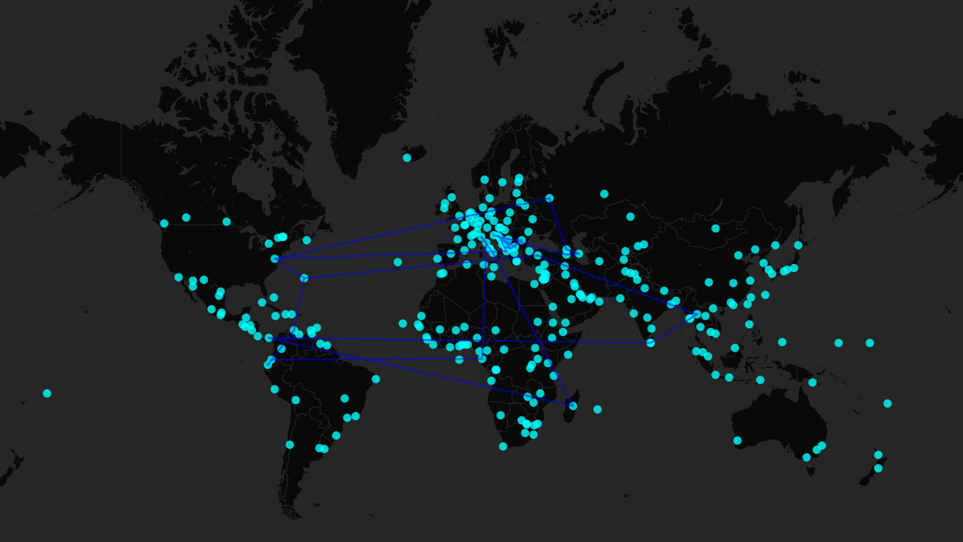
TRAFFICKING

Slide 16
BUSINESS

Slide 17
CULTURAL EXCHANGE

Slide 18
DEFENSE

Slide 19
EDUCATION

